Slide 1
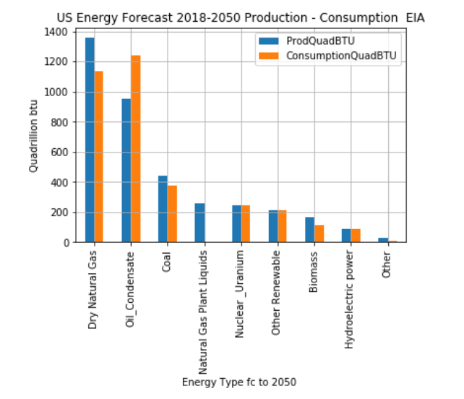
Total Energy Forecast by Type

Slide 2
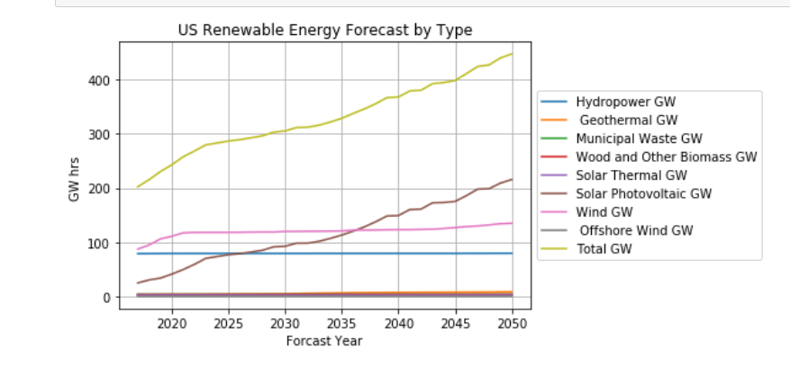
Renewable Energy Electric Power Sector Forecast
Renewable trend shows overall increase:
Solar source crosses Hydro power and then Wind in coming 15 year to lead this trend
EIA expects this that this portfolio will lead to more renewables

